Slide 1
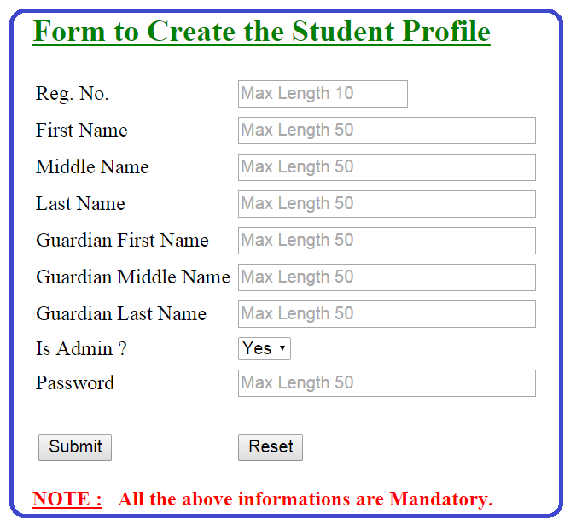

Slide 2
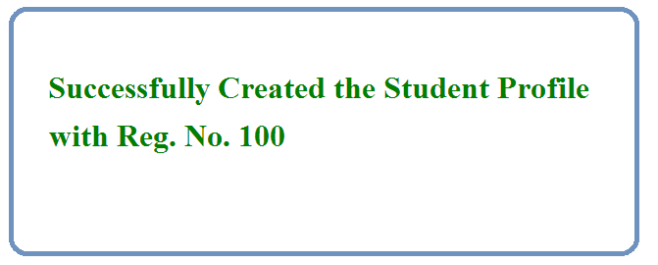


Slide 3
Java
JDBC
Driver
DB

Slide 4
Get Reg. No., First Name,
Middle Name, Last Name, Guardian First Name, Guardian Middle Name, Guardian Last Name, Is Admin & Password information's via
Command Line Arguments
Java
JDBC
Driver
DB
1. Load the Driver
2. Get the DB Connection via Driver
3. Issue SQL Queries via Connection
insert into students_info values (?, ?, ?, ?)
insert into guardian_info values (?, ?, ?, ?)
insert into students_otherinfo values (?, ?, ?)
4. Process the Results
Print Success / Error Message
5. Close All JDBC Objects

